Slide 1




My Algebra Interactive Notebook
$$3ab$$
$$2x+3y$$
$$\frac{5xy}{6}$$
Name :
Class :
Term 2 Semester 1
$$y=2x+1$$

Slide 2
Contents
Glossary
Page
Date
Description
2
3

Slide 3
Tasks
24
7
30
Essential Question
Questions
Notes
Summary
4
7

Slide 4
24
7
30
Date
Simplifying Expressions
EQ – What is a ‘like term’ and how do I collect them?

Slide 5
24
7
30
Date
Simplifying Expressions
EQ – What is a ‘like term’ and how do I collect them?
What are like terms?

Slide 6
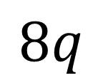
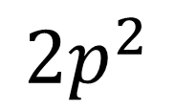
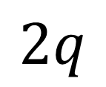
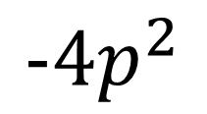
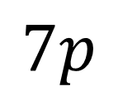
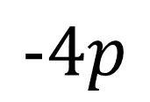
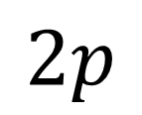

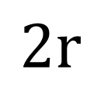
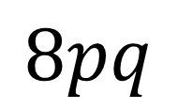
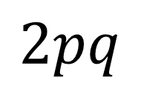
Match up the like terms
$$2p$$
$$2$$
$$−4p$$
$$7p$$
$$8pq$$
$$2q$$
$$2p^{2}$$
$$2r$$
$$8q$$
$$2pq$$
$$−4p^{2}$$

Slide 7
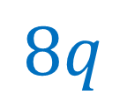
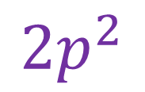
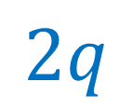
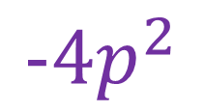
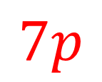
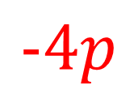
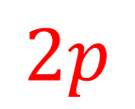

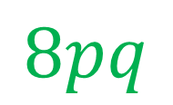
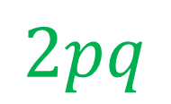
Match up the like terms
$$2p$$
$$2$$
$$−4p$$
$$7p$$
$$8pq$$
$$2q$$
$$2p^{2}$$
$$2r$$
$$8q$$
$$2pq$$
$$−4p^{2}$$

Slide 8

24
7
30
Date
Simplifying Expressions
EQ – What is a ‘like term’ and how do I collect them?
Like terms contain exactly the same variables with the same powers. The variables do not need to be in the same order.
What are like terms?
How do I simplify expressions by collecting like terms?
$$2t+4t=$$

Slide 9
24
7
30
Date
Simplifying Expressions
EQ – What is a ‘like term’ and how do I collect them?
Like terms contain exactly the same variables with the same powers. The variables do not need to be in the same order.
What are like terms?
How do I simplify expressions by collecting like terms?
$2t+4t=6t$ add or subtract the coefficients

Slide 10

24
7
30
Date
Simplifying Expressions
EQ – What is a ‘like term’ and how do I collect them?
Like terms contain exactly the same variables with the same powers. The variables do not need to be in the same order.
What are like terms?
How do I simplify expressions by collecting like terms?
$2t+4t=6t$ add or subtract the coefficients
$$6x+3y−4x$$
Identify like terms

Slide 11

24
7
30
Date
Simplifying Expressions
EQ – What is a ‘like term’ and how do I collect them?
Like terms contain exactly the same variables with the same powers. The variables do not need to be in the same order.
What are like terms?
How do I simplify expressions by collecting like terms?
$2t+4t=6t$ add or subtract the coefficients
$$6x+3y−4x$$
Identify like terms
Simplify

Slide 12
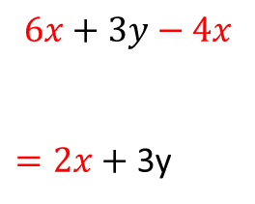
24
7
30
Date
Simplifying Expressions
EQ – What is a ‘like term’ and how do I collect them?
Like terms contain exactly the same variables with the same powers. The variables do not need to be in the same order.
What are like terms?
How do I simplify expressions by collecting like terms?
$2t+4t=6t$ add or subtract the coefficients
$$6x+3y−4x$$
$=2x+$ 3y
Identify like terms
Simplify

Slide 13
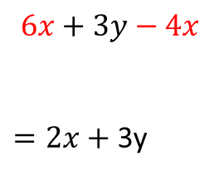
24
7
30
Date
Simplifying Expressions
EQ – What is a ‘like term’ and how do I collect them?
Like terms contain exactly the same variables with the same powers. The variables do not need to be in the same order.
What are like terms?
How do I simplify expressions by collecting like terms?
$2t+4t=6t$ add or subtract the coefficients
$$6x+3y−4x$$
$=2x+$ 3y
Identify like terms
Simplify

Slide 14

24
7
30
Date
Simplifying Expressions
EQ – What is a ‘like term’ and how do I collect them?
Like terms contain exactly the same variables with the same powers. The variables do not need to be in the same order.
What are like terms?
How do I simplify expressions by collecting like terms?
1.
$2t+4t=6t$ add or subtract the coefficients
2.
$$6x+3y−4x$$
$=2x+$ 3y
Identify like terms
Simplify
3.
$$3a−4b+2a−b$$
Identify like terms
Simplify

Slide 15

24
7
30
Date
Simplifying Expressions
EQ – What is a ‘like term’ and how do I collect them?
Like terms contain exactly the same variables with the same powers. The variables do not need to be in the same order.
What are like terms?
How do I simplify expressions by collecting like terms?
1.
$2t+4t=6t$ add or subtract the coefficients
2.
$$6x+3y−4x$$
$=2x+$ 3y
Identify like terms
Simplify
3.
$$3a−4b+2a−b$$
Identify like terms
Simplify

Slide 16

24
7
30
Date
Simplifying Expressions
EQ – What is a ‘like term’ and how do I collect them?
Like terms contain exactly the same variables with the same powers. The variables do not need to be in the same order.
What are like terms?
How do I simplify expressions by collecting like terms?
1.
$2t+4t=6t$ add or subtract the coefficients
2.
$$6x+3y−4x$$
$=2x+$ 3y
Identify like terms
Simplify
3.
$$3a−4b+2a−b$$
Identify like terms
Simplify

Slide 17

24
7
30
Date
Simplifying Expressions
EQ – What is a ‘like term’ and how do I collect them?
Like terms contain exactly the same variables with the same powers. The variables do not need to be in the same order.
What are like terms?
How do I simplify expressions by collecting like terms?
1.
$2t+4t=6t$ add or subtract the coefficients
2.
$$6x+3y−4x$$
$=2x+$ 3y
Identify like terms
Simplify
3.
$$3a−4b+2a−b$$
Identify like terms
Simplify
$$=5a−5b$$

Slide 18
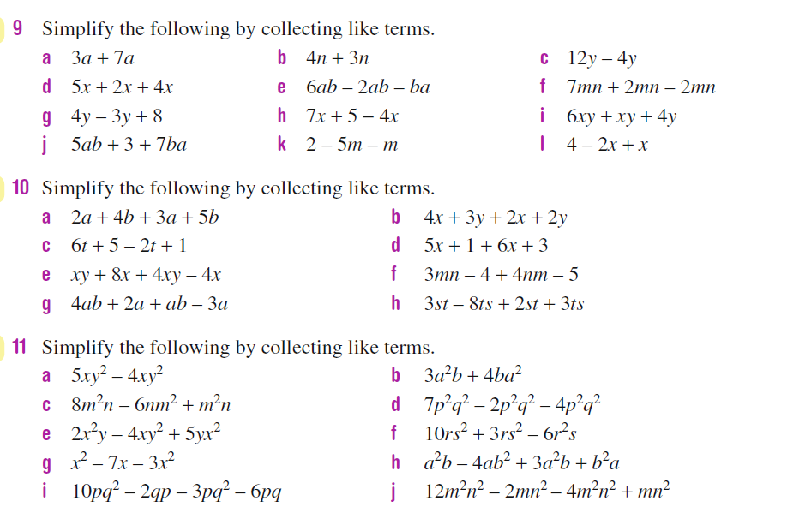
Task

Slide 19
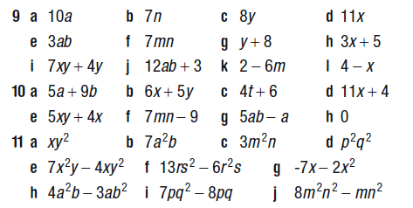
Answers

Slide 20
Notes Review
24, 7 ,30
Date
Title
Essential question
Notes complete
Notes complete with colour and diagrams
Questions completed
Contents page filled in
Formula page filled in

Slide 21
Homework
Review your notes and write a summary answering the essential question.

